Slide 1


ARTIFICIAL INTELLIGENCE
(Recommender Systems)
Dr. Zeyad Ahmed

Slide 2
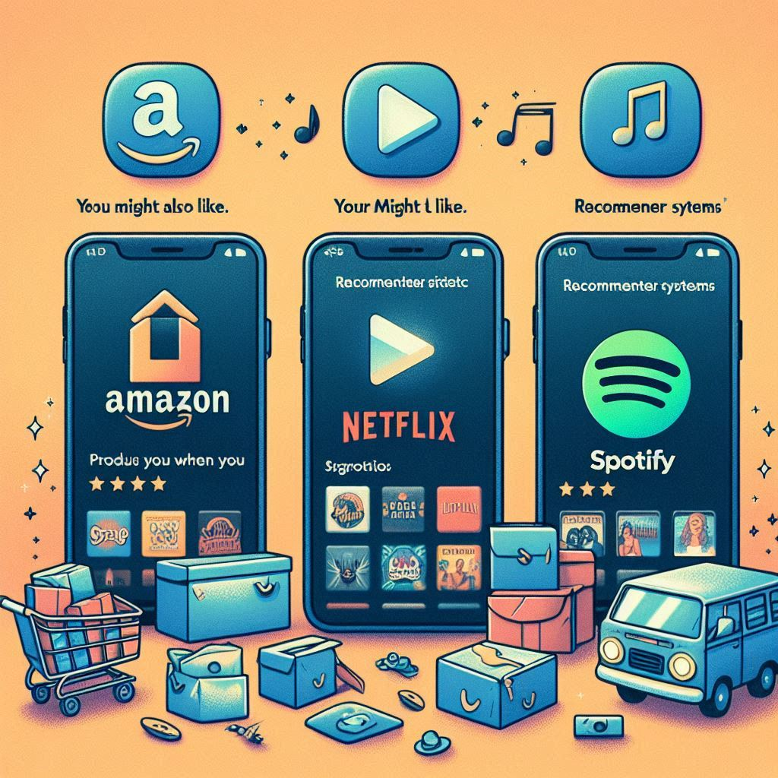

Slide 3
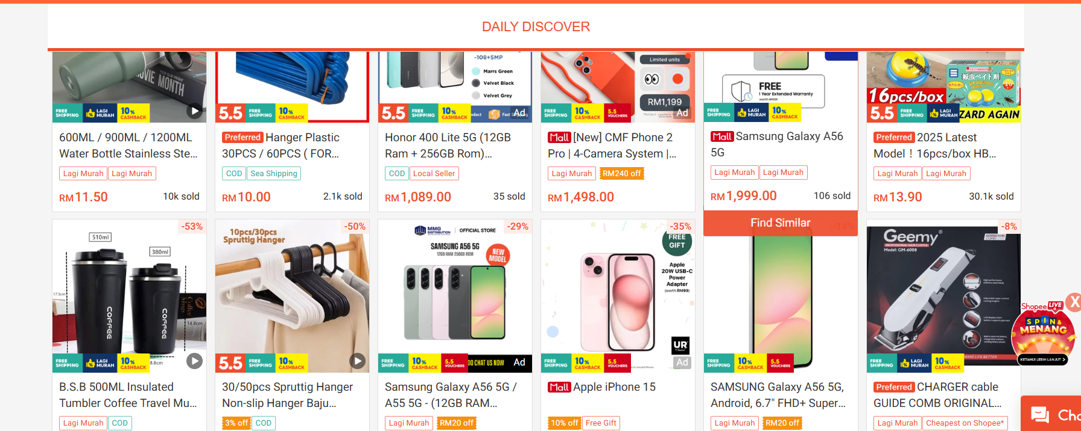
Shopee

Slide 4
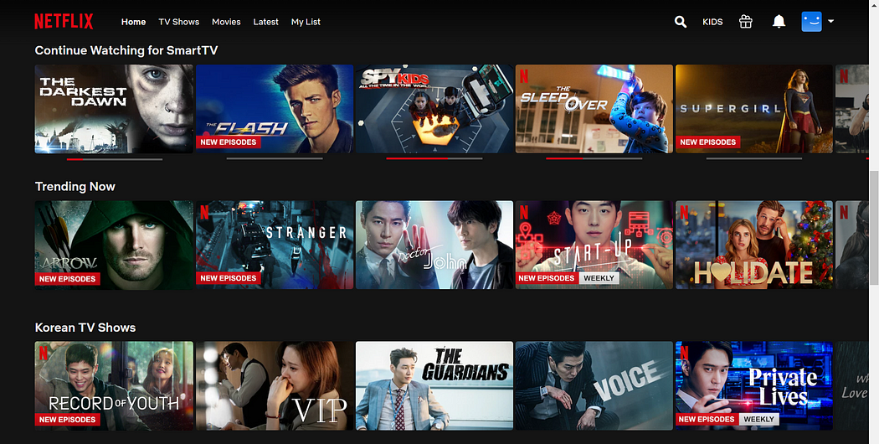
NeTFLIX

Slide 5
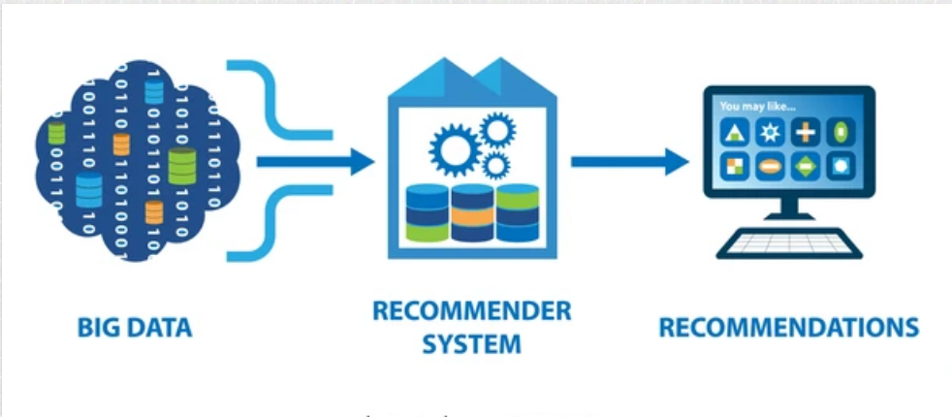

Slide 6
Defining Recommender Systems
Definition: Recommender Systems are smart systems that predict what items (like movies, products, music, articles) a user will like and suggest them. They are a type of information filtering system.
Recommender Systems are algorithms designed to:
  Predict user interests.
  Suggest relevant items to individual users.
This prediction and recommendation process is typically based on analyzing patterns within a dataset.
The objective is to enhance the user experience and achieve business goals.

Slide 7
Why are they so popular?
They make online platforms easier and more enjoyable to use by reducing effort in finding desired items.
They help companies sell more by showing relevant items that users are likely to purchase or engage with.
They introduce users to new things they might not have found otherwise, promoting discovery.

Slide 8
Why Do We Need Recommender Systems?
Information Overload: The internet has a massive amount of content (like a giant library).
Difficulty Finding Items: It's nearly impossible for users to manually find what they like among so many choices.
User Frustration: Too much content without guidance leads to users feeling overwhelmed and potentially leaving the platform.
Solution: Recommender systems act as guides (like a personal assistant) to filter irrelevant information and highlight interesting items based on user tastes.

Slide 9
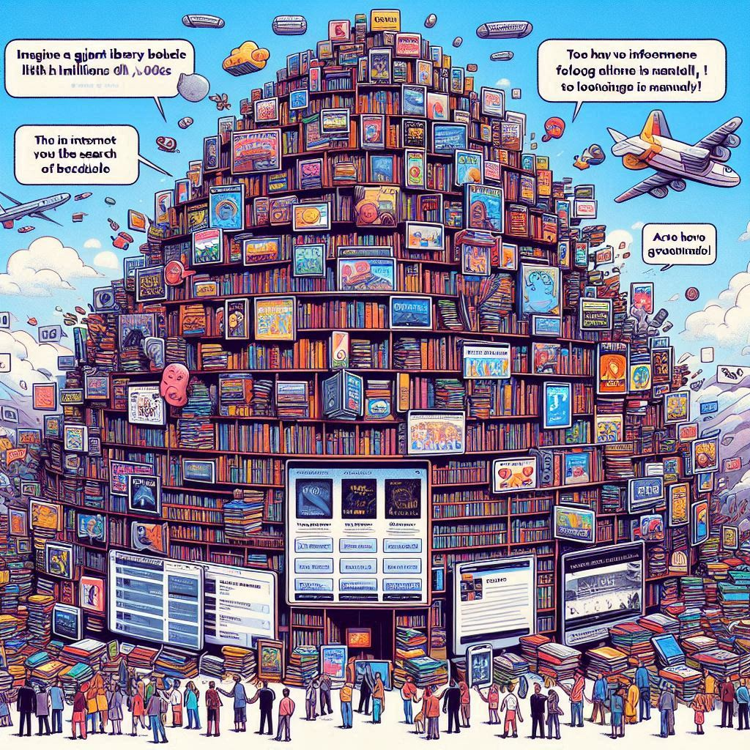
Why Do We Need Recommender Systems?

Slide 10
How Do They Work? Filtering Techniques
Recommender systems use different strategies, called filtering techniques, to analyze data and figure out what you might like.
These techniques look at different kinds of information to make their predictions. The choice of technique depends on the available data and the specific problem.

Slide 11
Types of filters
Content-Based Filtering – suggests items similar to what a user liked before.
Collaborative Filtering – recommends based on similar users/items.
Hybrid Filtering – combines content-based + collaborative.
Demographic Filtering – uses user profile info (age, gender, etc.).
Context-Aware Filtering – considers situation (time, location, mood).

Slide 12
Collaborative Filtering
"People like you enjoy"
Finds users with similar tastes and recommends what they liked.
Example: You and Sarah liked the same 10 movies, so you get Sarah's other favorites.

Slide 13
Collaborative Filtering
How it works:
Gather Data: Collect data on user-item interactions. This is often represented in a user-item matrix where rows are users, columns are items, and values represent interactions (e.g., ratings, watch time, purchase history).

Slide 14
Collaborative Filtering
User \ Item | Movie A | Movie B | Movie C | Movie D
User 1 | 5 | 3 | 0 | 1
User 2 | 4 | 0 | 2 | 0
User 3 | 0 | 4 | 5 | 3

Slide 15
Collaborative Filtering: The "People Like You" Method
Find Similarities: Calculate similarity between users (user-based) or between items (item-based) based on this interaction data. Similarity can be measured using metrics like cosine similarity or Pearson correlation.
Generate Recommendations: Based on the calculated similarities, predict how the active user would rate or interact with items they haven't seen and recommend the highest-predicted items.

Slide 16
Collaborative Filtering
User-Based Collaborative Filtering:
  Focus: Finding users similar to you (the active user).
  Process: Identify a group of users whose interaction history is most similar to yours.
  Recommendation: Recommend items that these "neighbor" users liked but you haven't seen or interacted with yet.
  Example: "User A and User B both gave high ratings to movies X, Y, and Z. User B also gave a high rating to Movie Q, but User A hasn't seen it. The system recommends Movie Q to User A."
  Analogy: Asking friends with similar music taste for band recommendations – if they all like a new band, you might too.

Slide 17
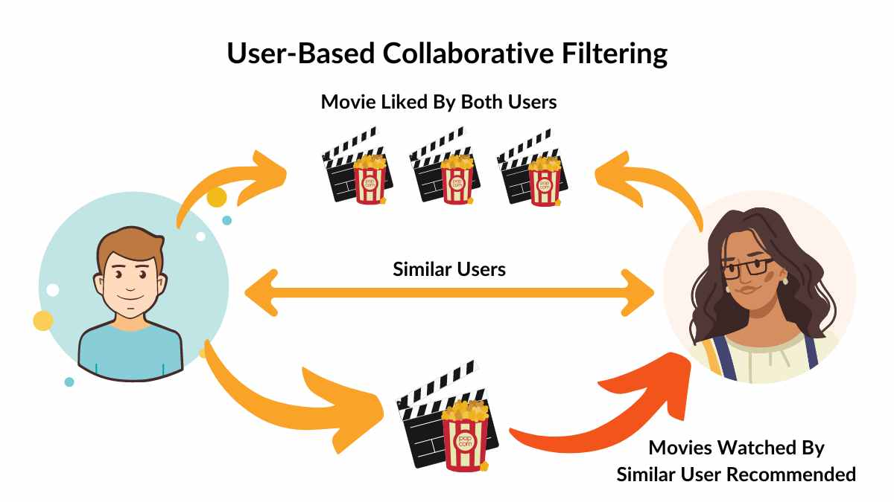
Collaborative Filtering

Slide 18
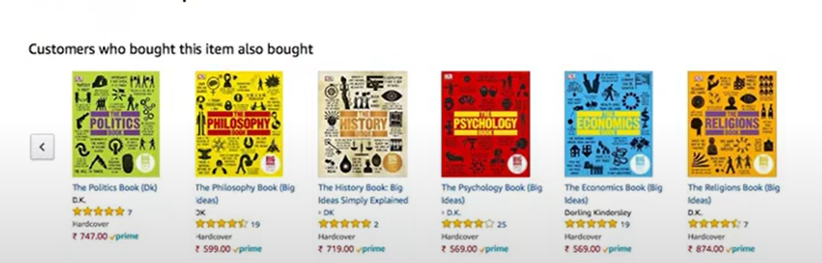
Collaborative Filtering
User-Based Collaborative Filtering:

Slide 19
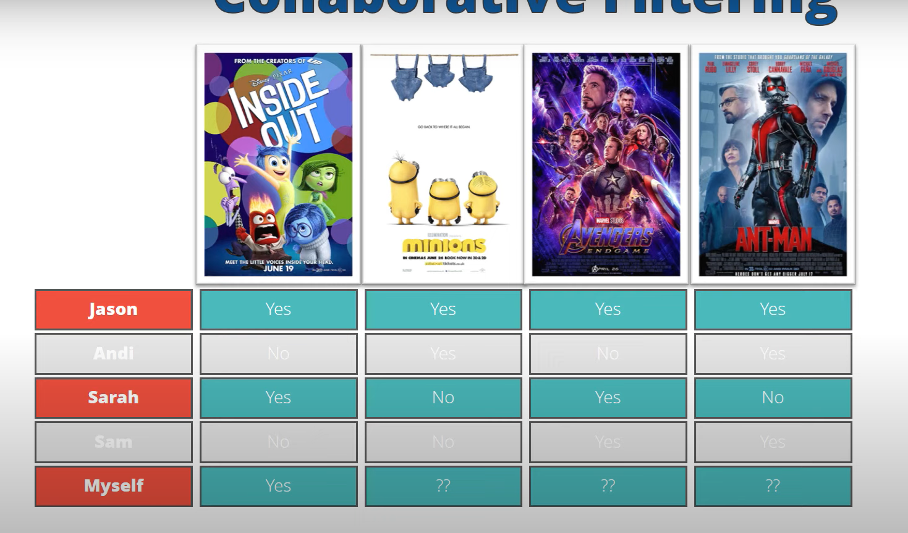
Collaborative Filtering
User-Based Collaborative Filtering:

Slide 20
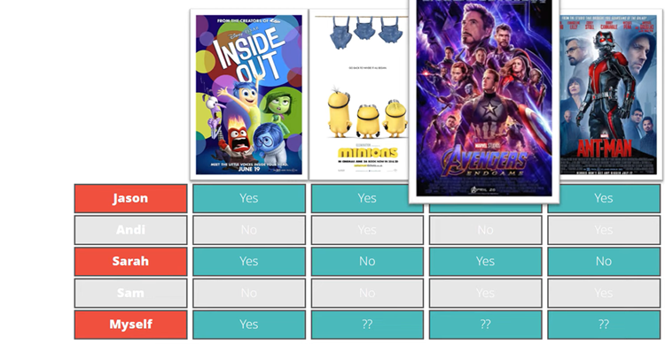
Collaborative Filtering
User-Based Collaborative Filtering:

Slide 21
Collaborative Filtering: Two Approaches
Item-Based Collaborative Filtering:
Focus: Finding items similar to the ones you liked.
Process: Identify items that are similar to the items you've liked or interacted with, based on how other users have interacted with both items.
Recommendation: Recommend these similar items to the active user.

Slide 22
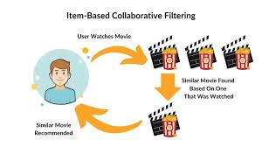
Collaborative Filtering

Slide 23
Collaborative Filtering
Example: "People who bought 'The Lord of the Rings' book also frequently bought 'The Hobbit'. If User C bought 'The Lord of the Rings' but not 'The Hobbit', the system recommends 'The Hobbit' to User C."
Analogy: Seeing that people who bought the same type of coffee as you also bought a specific type of tea – the system identifies a relationship between the coffee and the tea based on group purchasing behavior.

Slide 24
Collaborative Filtering: Pros and Cons
Pros:
Discovery: Can recommend surprising items you wouldn't have found otherwise, as it leverages the collective intelligence of users.
No Item Content Needed: Doesn't need to understand the item's content (like actors), just user interactions. This is useful for items where features are hard to define (e.g., abstract art).
Works well for complex items like movies or music where taste is subjective and hard to capture with simple features.
Cons:
Cold-Start Problem: Struggles with new users (no interaction history) and new items (no interaction data). It needs sufficient data to find similarities.
Sparsity: In large systems, most users only interact with a small fraction of items, leading to a sparse user-item matrix, which can make finding reliable similarities difficult.
Computationally expensive for very large numbers of users or items, especially for user-based approaches, as it requires calculating similarities between many pairs.

